Slide 1
Summer Project : College Notes Drive
Name :- Rahul Danveer Gupta
Roll No:-27

Slide 2
INTRODUCTION
As the world is being developed with the new technologies, discovering and manipulating new ideas and concepts of taking everything online are rapidly changing. It is difficult for teachers to circulate their notes to each and every student whom is he/she teaching. Notes Gallery provide an easy approach for both students and teachers to circulate the notes whether of any kind like lecture notes, assignment questions, question papers and all the important documents.
The teachers and students can upload the documents from anywhere and students can download it. Overall it is managed by the admin.

Slide 3
Problem Definition
There are many students who face problem in studying at the exam time because either they don’t have the notes provided by teachers or they must have not been in the college. This System will provide a platform to easily access the notes.
A useful fact-finding technique is to research the application or the problem that you are dealing with and want to put within a database. Computer trade journals, reference books, and the Internet are good sources of information which can make available of huge quantity of information on how others have solved similar problems/issues plus whether or not any software packages exist to resolve or even partially solve your current problem.

Slide 4
Objective of Project
The Objective of Notes Drive is to provide better facility to the students and teachers to bring out the easy circulation of documents within healthy environment. It will reduce the manual paperwork, reduced the sharing and distribution time.

Slide 5
Software Requirements
WINDOWS OPERATING SYSTEM
PHP
MySQL
HTML, CSS, JAVASCRIPT, BOOTSTRAP
XAMP
APACHE SERVER
SUBLIME TEXT EDITOR

Slide 6
Module Specification
Student: Students register on the website and login to access the notes uploaded by teachers and view them or download it.
Teacher: The teacher has to first register on the website and then login to upload the note. Teacher can even delete the notes by logging in.
Notes: Notes can be uploaded and deleted by teacher and student. It can be downloaded by every student and teacher.
Admin: The notes are managed by admin. He has rights to approve or disapprove the notes uploaded by particular user.

Slide 7
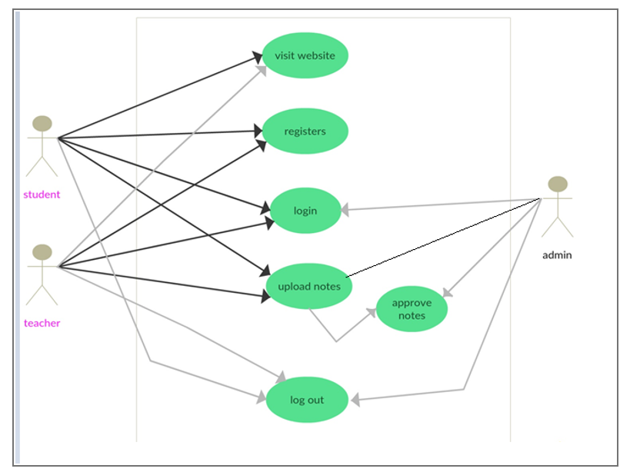
Use Case

Slide 8
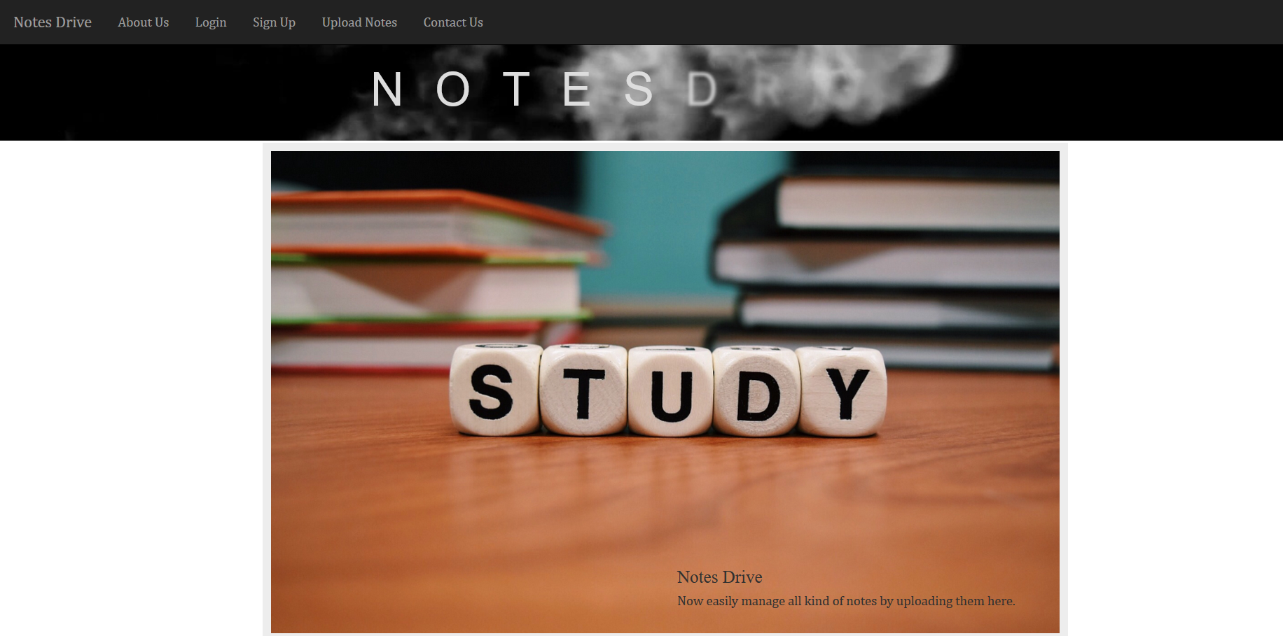
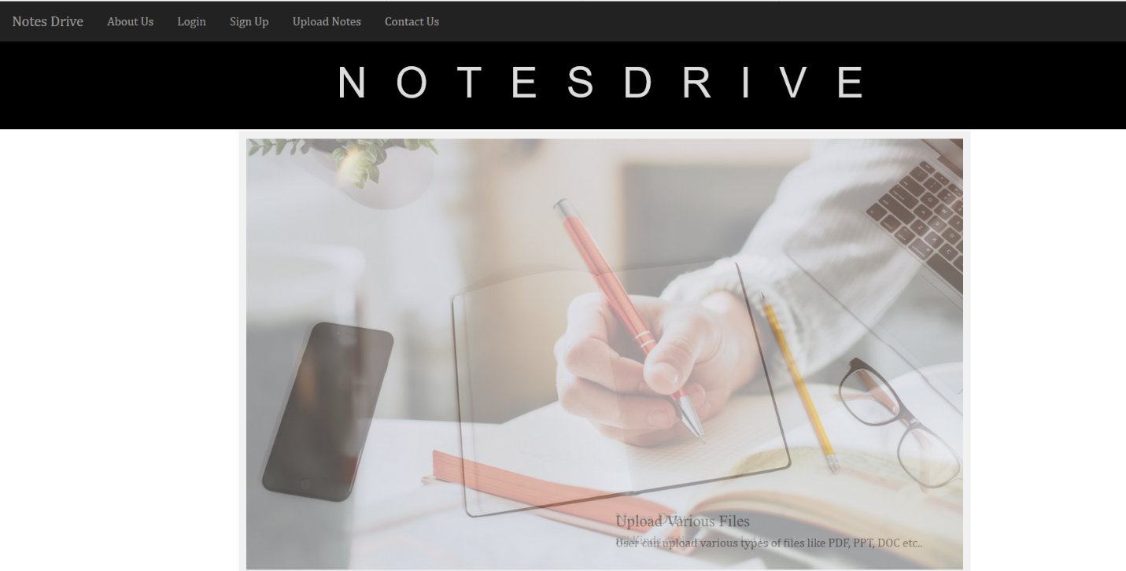
Homepage

Slide 9
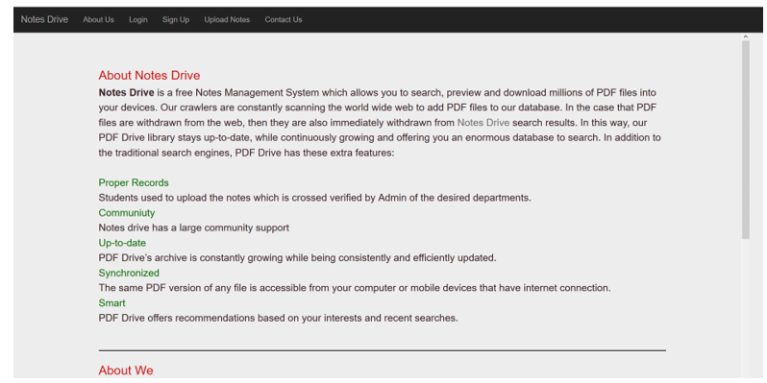
About us

Slide 10
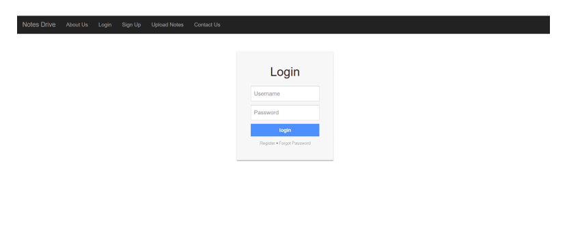
Login Page

Slide 11
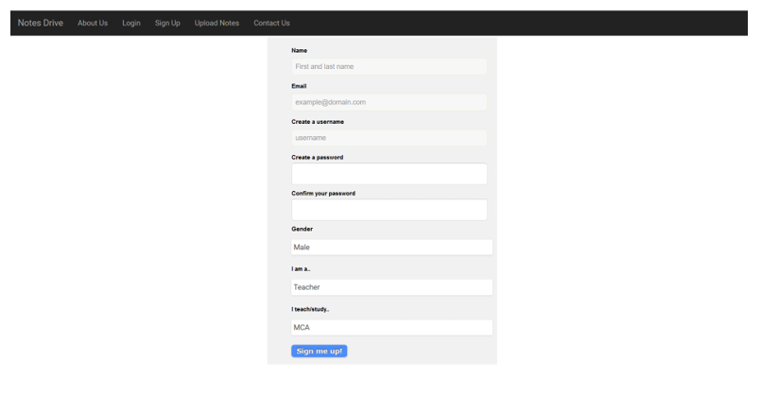
Register Page

Slide 12
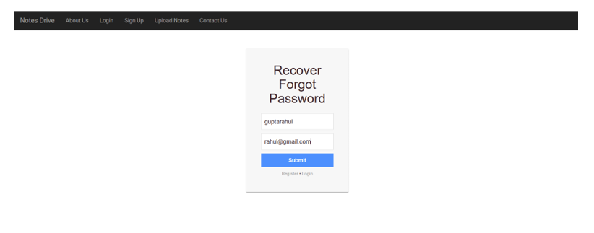
Forgot Password

Slide 13
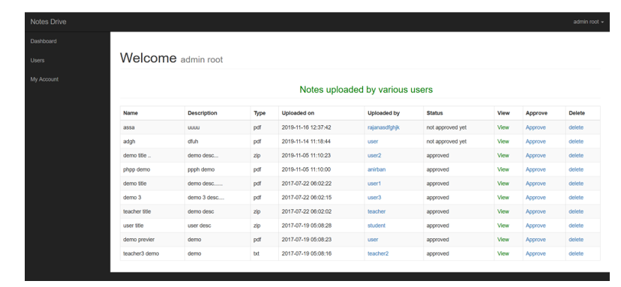
Admin Dashboard Page

Slide 14
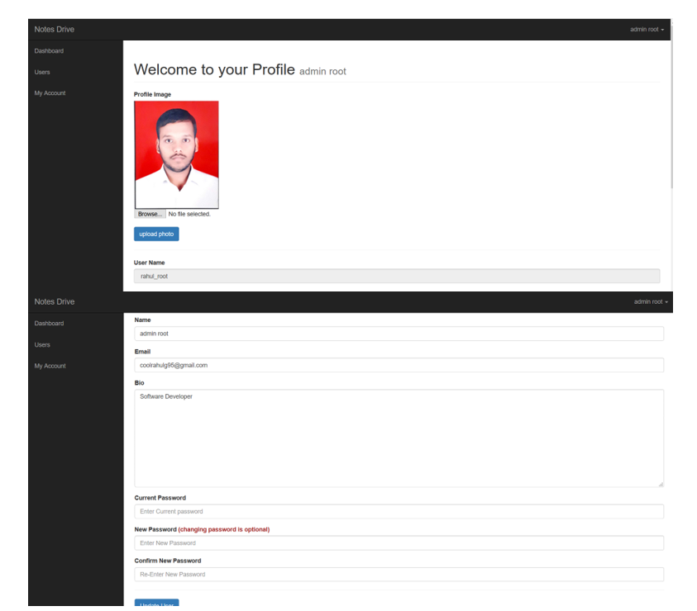
Update Profile Page

Slide 15
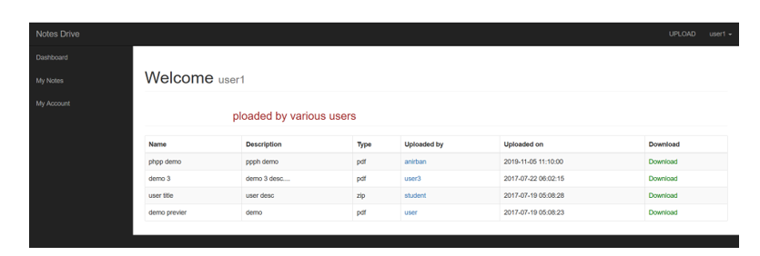
User Dashboard Page

Slide 16
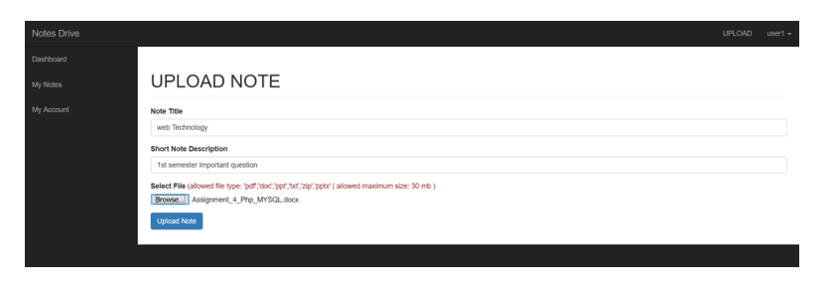
Upload Note Page

Slide 17
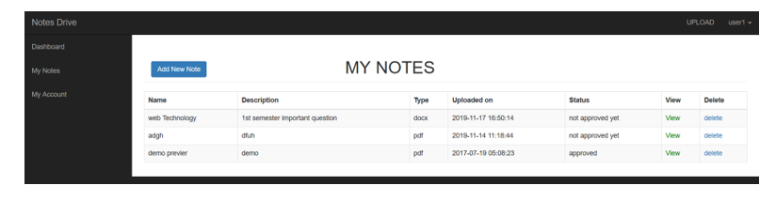
Uploaded Note Pages

Slide 18
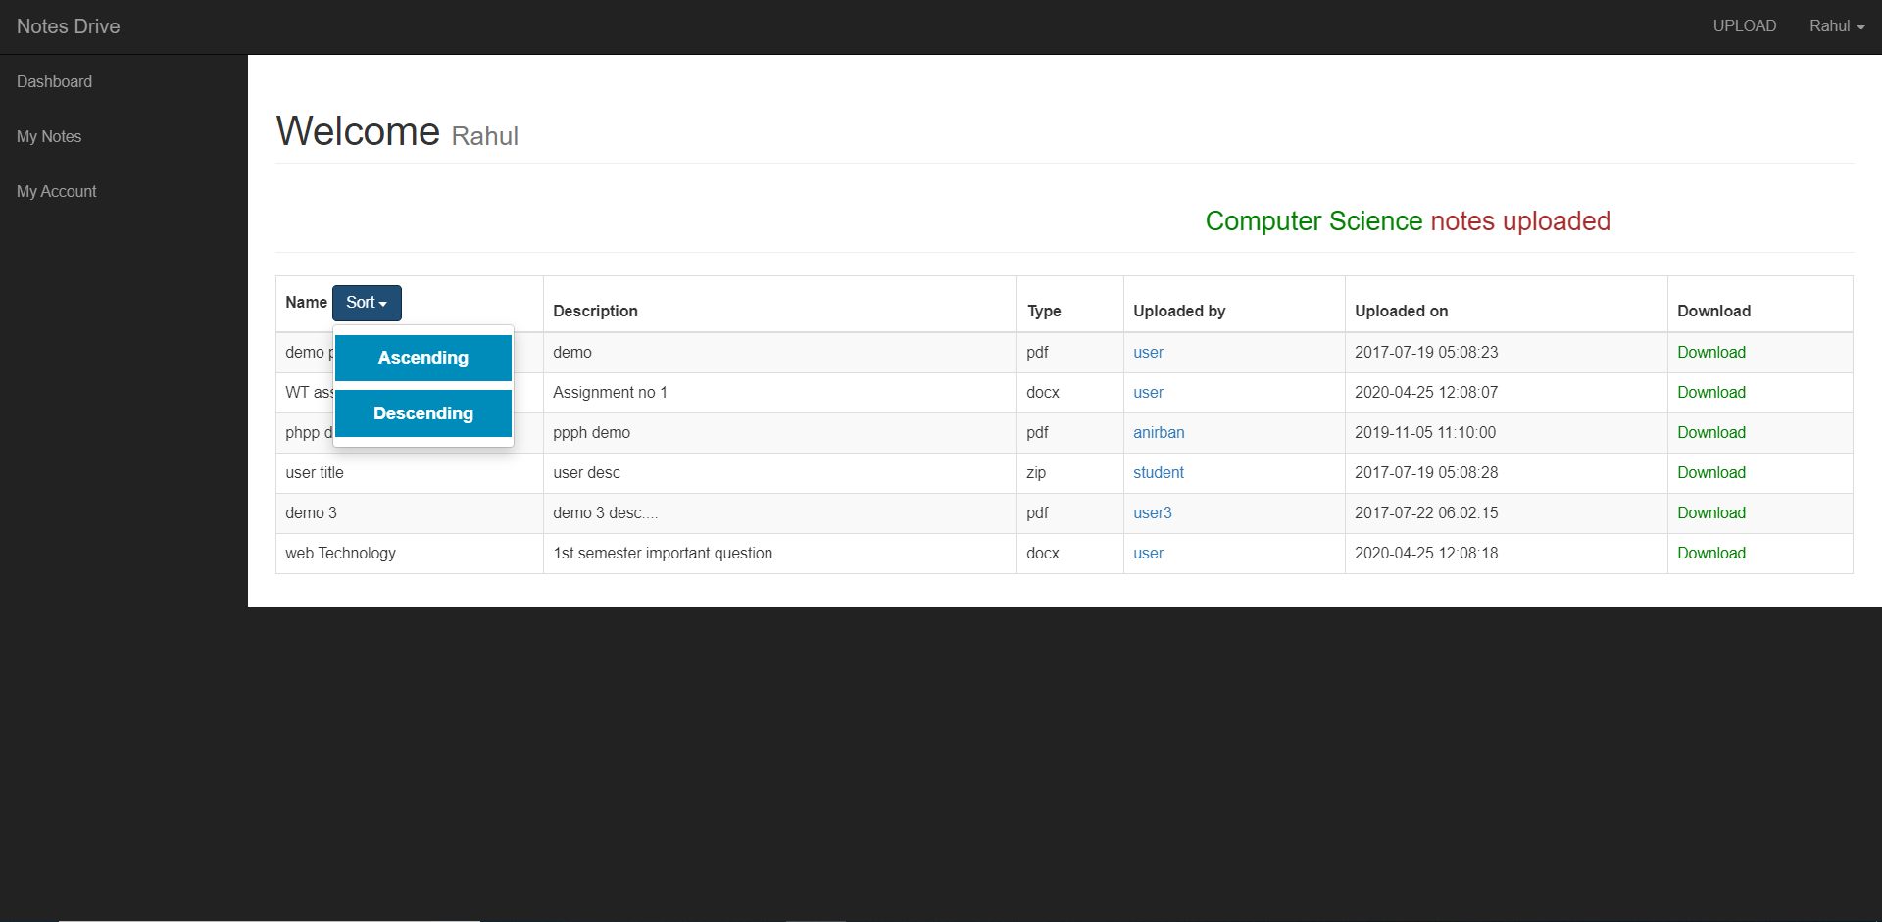
Name Ascending and Descending

Slide 19
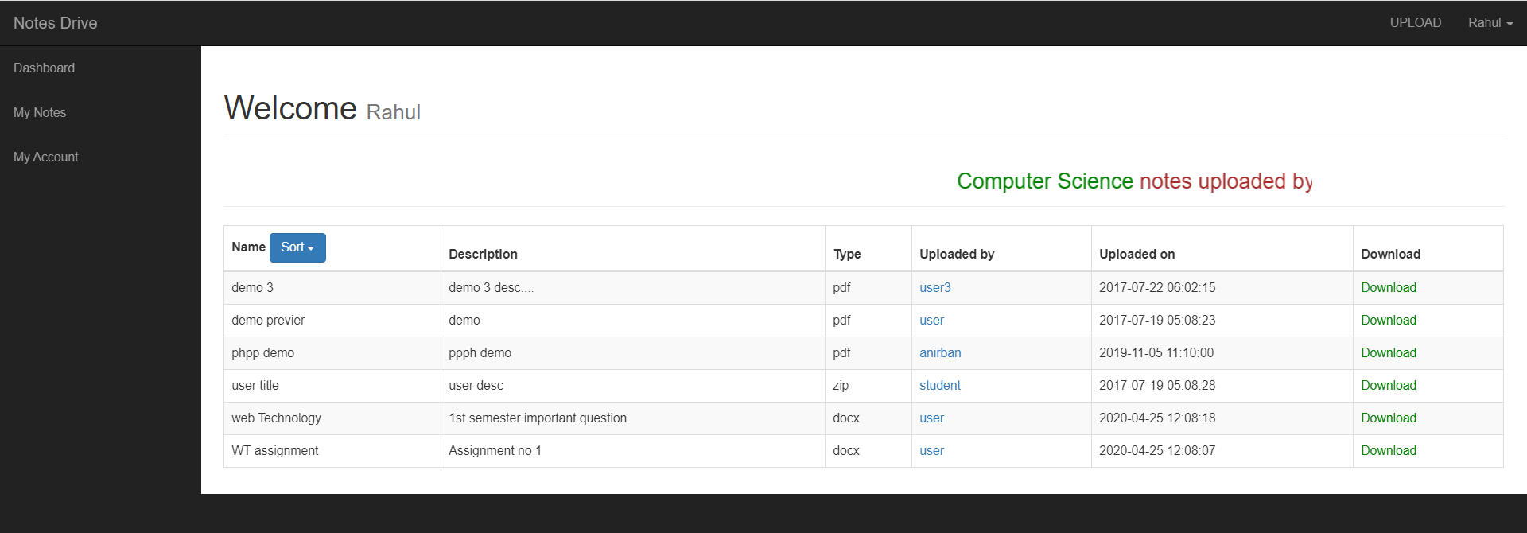
Ascending Order Name

Slide 20
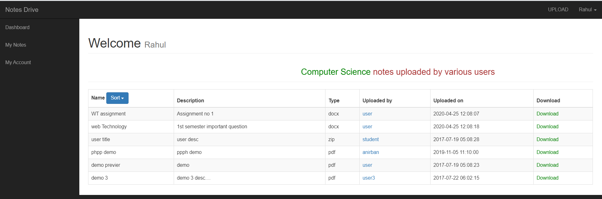
Descending Order Name

Slide 21
Conclusion and Future Scope
It has been a matter of immense pleasure, honors and challenge to have this opportunity to take up this project and complete it successfully. It was a nice experience working with the Group Partner. This will be helpful when we will work in industry & educational field where we can put all these it in our practice.
While developing this Website NOTES DRIVE, I have learnt a lot about the working of system.
This website provides a computerized version of online Notes Drive which will benefit the students as well as the Teachers of the nation. It makes entire process online where student and teacher can search Notes. It also has a facility for student login and Teachers can login and can see the different kind of Notes available on this Notes drive and they can also upload their notes. It has a facility of teacher’s login where teachers can add lectures notes and also give necessary suggestion to students.
There is a future scope of to make easily available all notes and shared from each other in the Notes Drive website. This project thus making it more interactive more user friendly and project which fulfils each user need in the best way possible.

